Slide 1
Descriptive Statistics in Ap bio
Take some notes:
Center: mean, median and mode
Spread: range, standard deviation (SD) and Standard Error of the Mean (SEM)
Let’s start with an example.
Data set of how many drops of water could fit on the head of a nail ☺.
Find mean, median and mode of each data set.
Data set B | # drops of water
Trial 1 | 1
Trial 2 | 2
Trial 3 | 3
Trial 4 | 4
Trial 5 | 5
Data set A | # drops of water
Trial 1 | 3
Trial 2 | 3
Trial 3 | 3
Trial 4 | 3
Trial 5 | 3
Calculations | Center Stats
Mean | 3
Median | 3
Mode | 3
Calculations | Center Stats
Mean | 3
Median | 3
Mode | None

Slide 2
Descriptive stats - spread
Calculate Range for each set
Data set B | # drops of water
Trial 1 | 1
Trial 2 | 2
Trial 3 | 3
Trial 4 | 4
Trial 5 | 5
Data set A | # drops of water
Trial 1 | 3
Trial 2 | 3
Trial 3 | 3
Trial 4 | 3
Trial 5 | 3
Calculations | Center Stats
Range | 0
Standard Deviation (SD)
Standard Error of the Mean (SEM)
Calculations | Center Stats
Range | 4
Standard Deviation (SD)
Standard Error of the Mean (SEM)

Slide 3
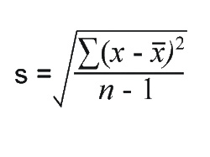
Standard deviation:
“summation” – or add them all up
Standard deviation: how measurements for a group are spread out from the average (mean), or expected value.
Low standard deviation: most numbers are close to average.
High standard deviation: numbers are more spread out.
Look at equation sheet to figure out what each symbol means.

Slide 4
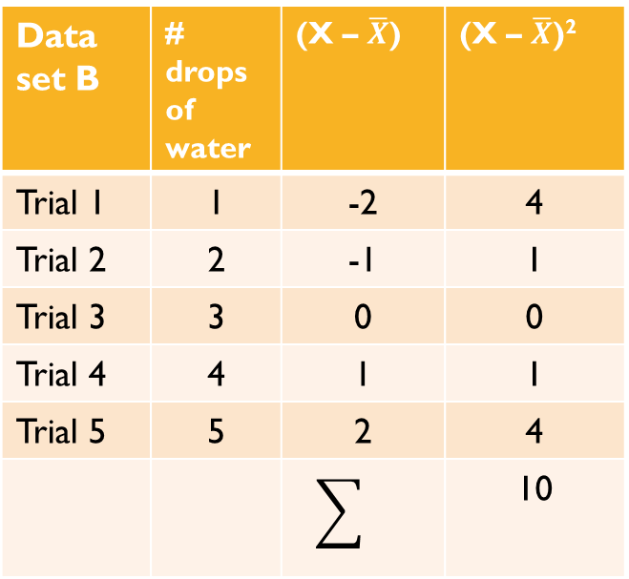
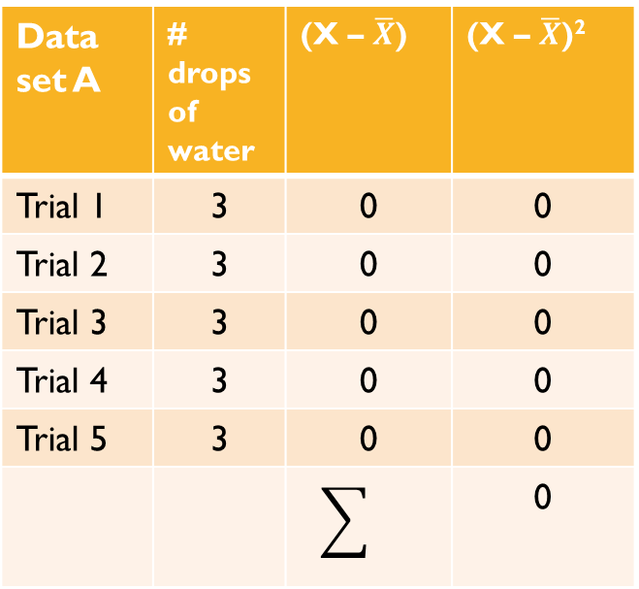
Data set A | # drops of water | (X – $\overline{X}$) | (X – $\overline{X}$)²
Trial 1 | 3 | 0 | 0
Trial 2 | 3 | 0 | 0
Trial 3 | 3 | 0 | 0
Trial 4 | 3 | 0 | 0
Trial 5 | 3 | 0 | 0
 |  |  | 0
Data set B | # drops of water | (X – $\overline{X}$) | (X – $\overline{X}$)²
Trial 1 | 1 | -2 | 4
Trial 2 | 2 | -1 | 1
Trial 3 | 3 | 0 | 0
Trial 4 | 4 | 1 | 1
Trial 5 | 5 | 2 | 4
 |  |  | 10
SD = 0 Calculate SD

Slide 5

Calculate the standard deviation for set b
$$\sqrt{\left(1−3\right)2+\left(2−3\right)2+\left(3−3\right)2+\left(4−3\right)2+(5−3})2$$
⁽⁵⁻¹⁾
⁼ $\sqrt{}10/4$
^{= √2.5}
^{S (or SD) = 1.58}
^{You did it!!}

Slide 6
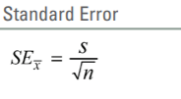
Standard error of the mean (sem)
An estimate of how much your mean varies from the actual mean of means if you did this experiment repeatedly..
Or how much your data varies from what is likely the actual mean (which can theoretically be found if we did over 100 trials of this experiment).
Easy to find!!
Calculate this!
1.58/ 2.24
=0.705

Slide 7
What is a 95% confidence interval?
Check out this website for a little help here – math if fun.
If we repeat this experiment 100 times, 95 times the mean will fall within this interval.
Find your 95% confidence interval by multiplying the SEM x 2
Graph your means and include ± 95% confidence interval error bars.. Z=2

Slide 8
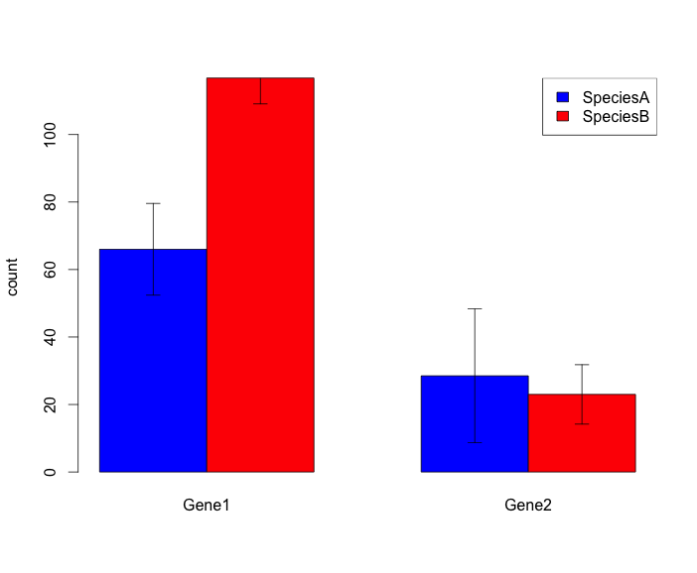
What do the error bars mean?
If the error bars overlap, data is inconclusive, or the difference between the means is considered not statistically significant.
We “fail to reject” our null hypothesis that there is no difference between condition A and ………
Which conditions in this graph show significant difference?
Which conditions are inconclusive or were not “significantly different”?

